Slide 1
Investigation of Image Classification based on Transfer Learning and Siamese Network
Ke Fan, Abdullateef Almudaifer, Sungman Kang

Slide 2
Agenda
Objective
Dataset
Transfer Learning
Implementation 1
Siamese Network
Implementation 2
Evaluation

Slide 3
Objective
Compare a simple Siamese network features with transfer learning approach on shoes dataset classification accuracy.
Investigate the effect of Siamese network on the features from transfer learning.

Slide 4
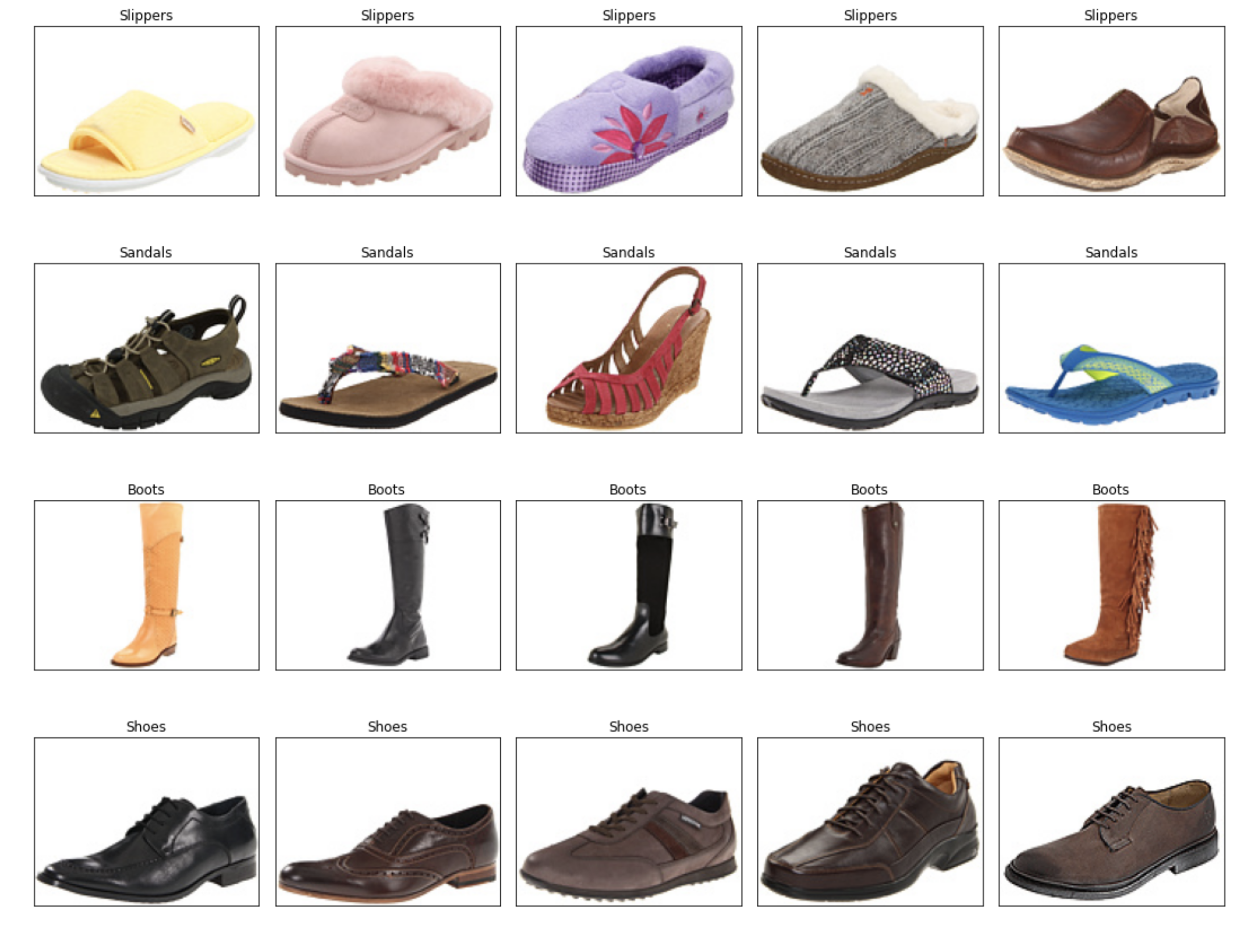
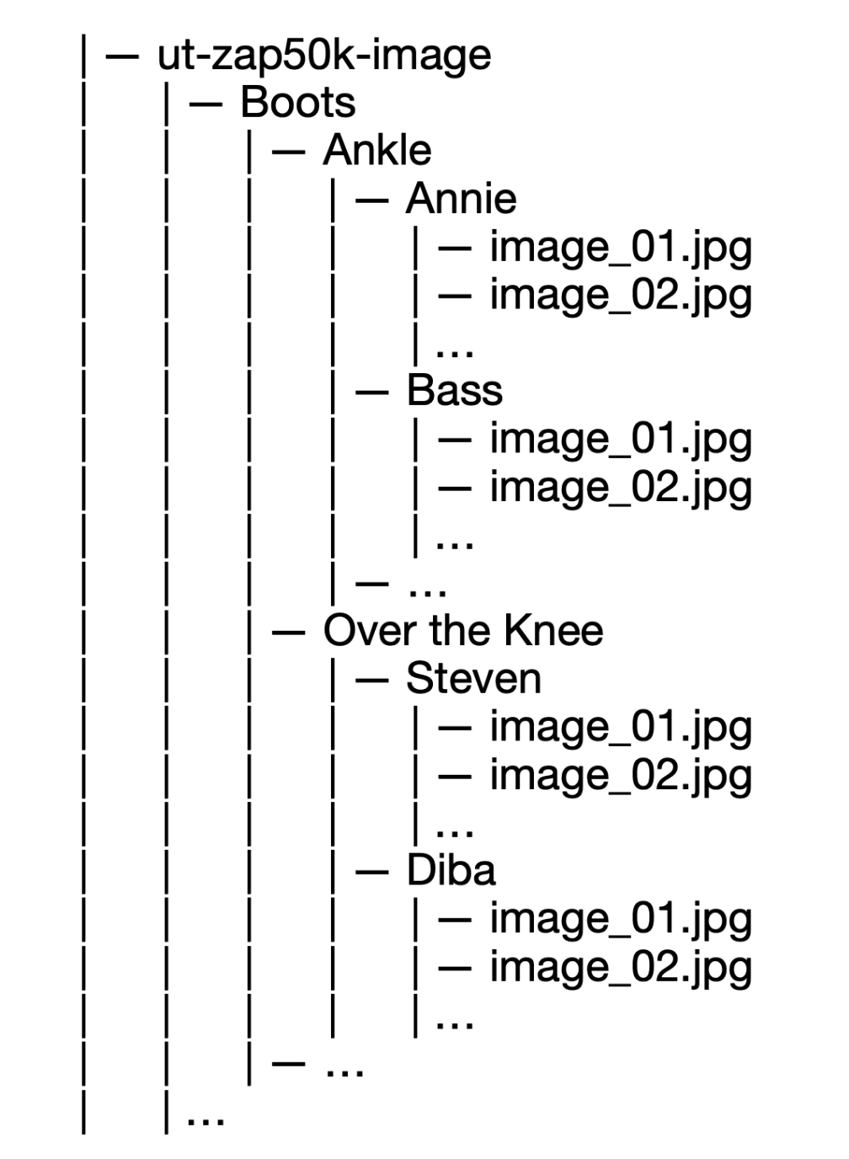
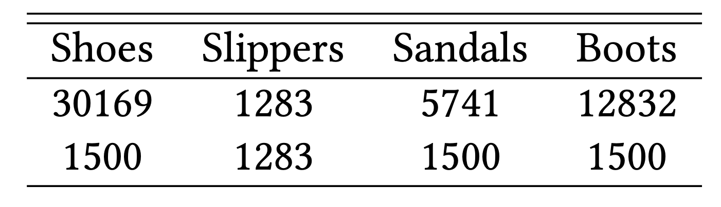
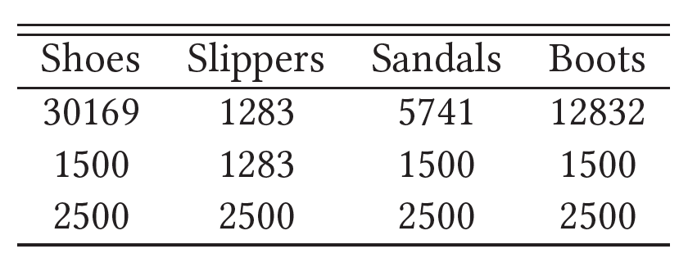
Dataset
Fig.1: Examples from the dataset.
http://vision.cs.utexas.edu/projects/finegrained/utzap50k/

Slide 5
Transfer Learning

Slide 6
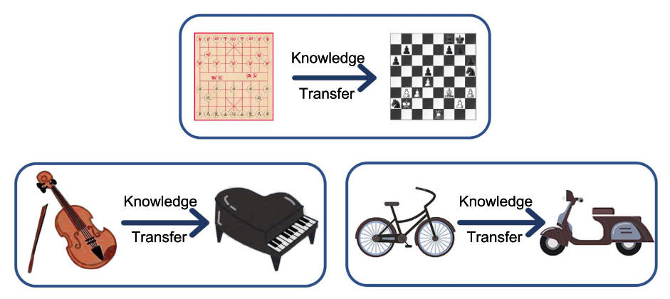
Transfer Learning
Fig. 2: Intuitive examples about transfer learning.
Source: A Comprehensive Survey on Transfer Learning https://arxiv.org/pdf/1911.02685.pdf

Slide 7
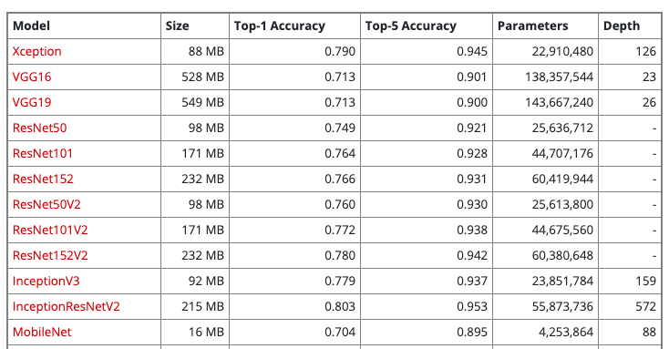
Xception
Table 1: part of available models on Keras applications
https://keras.io/api/applications/

Slide 8
Xception
Fig. 3: Xception architecture
Xception: Deep Learning with Depthwise Separable Convolutions https://arxiv.org/pdf/1610.02357.pdf

Slide 9
Implementation
scores
Probabilities
shoes
shoes
G.A.B
sandals
sandals
Xception
softmax
slippers
slippers
3, 3, 2048
2048
boots
boots
scores
Probabilities
FC
+
Relu
shoes
shoes
sandals
sandals
Xception
G.A.B
softmax
slippers
slippers
2048, 3, 3
2048
boots
boots
512
Figure 4: implemented transfer learning architectures. G.A.B: GlobalAveragePooling

Slide 10
Siamese Network

Slide 11
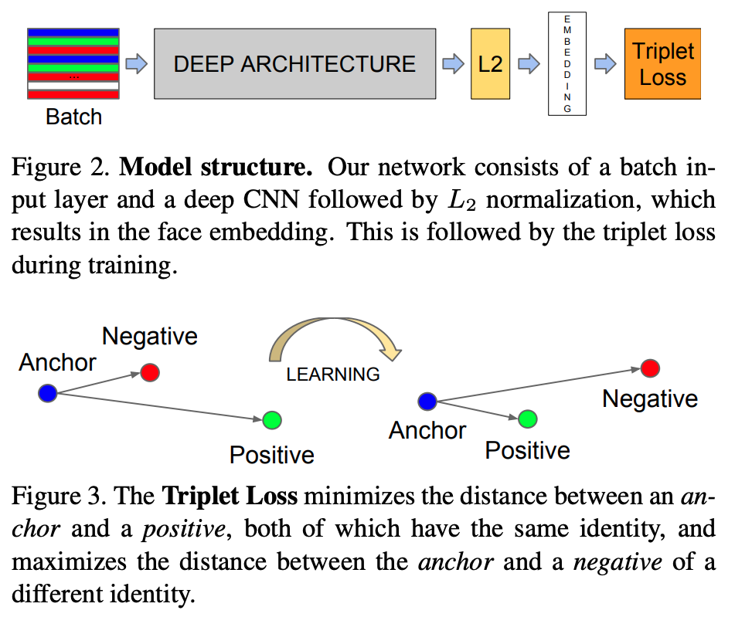
Siamese Network
FC
Loss
Classes
Our network consists of a batch input layer and a deep CNN followed by L2 normalization, which results in the image embedding. This is followed by a loss function during training. Furthermore, we add one more FC layer to generate classes output.
SCHOOL OF - to apply in all slides at the same time edit in Insert > Header & Footer

Slide 12
Siamese Network
FC
Loss
Classes
Our network consists of a batch input layer and a deep CNN followed by L2 normalization, which results in the image embedding. This is followed by a loss function during training. Furthermore, we add one more FC layer to generate classes output.
SCHOOL OF - to apply in all slides at the same time edit in Insert > Header & Footer

Slide 13
Typical CNN Architecture

Slide 14
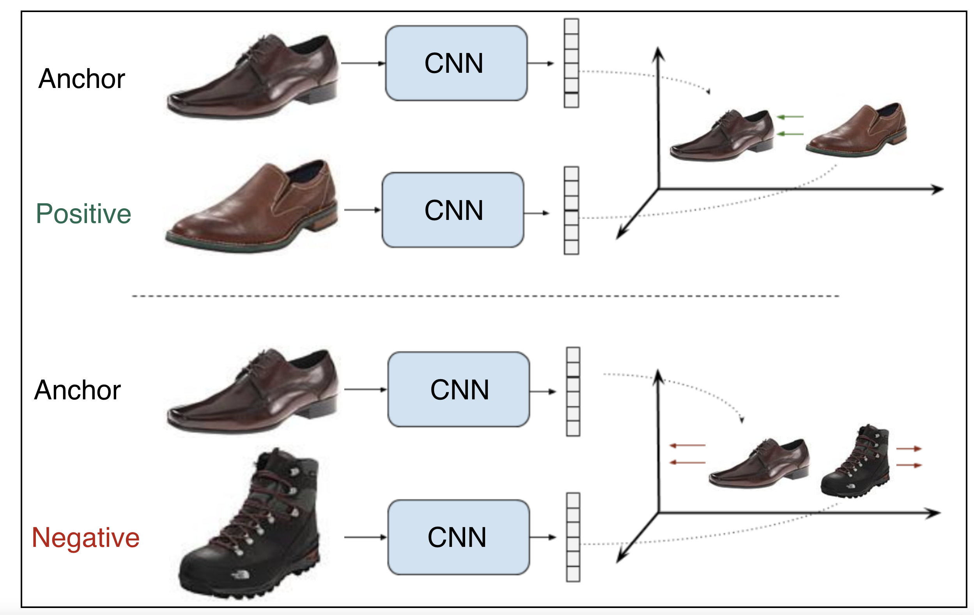
Contrastive Loss
Shared weights
pull
push
Shared weights
Figure X: Example of a contrastive ranking loss training setup
SCHOOL OF - to apply in all slides at the same time edit in Insert > Header & Footer

Slide 15
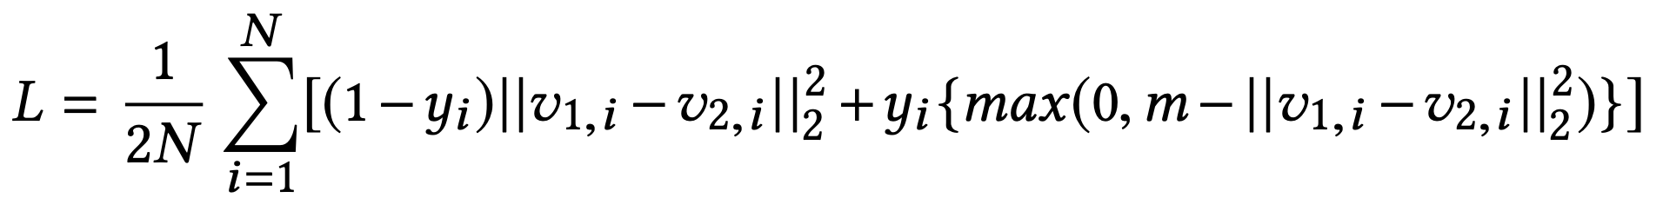
Contrastive Loss
Assume x_{a,i},x_{p,i},x_{n,i} are the anchor sample, positive sample and negative sample in a triplet respectively. v_{a,i},v_{p,i},v_{n,i} are their correspondent embedding vectors. y_{i} is the binary label that equals 1 for a positive pair and 0 for a negative pair. m is the marge and N is the batch size.
SCHOOL OF - to apply in all slides at the same time edit in Insert > Header & Footer

Slide 16
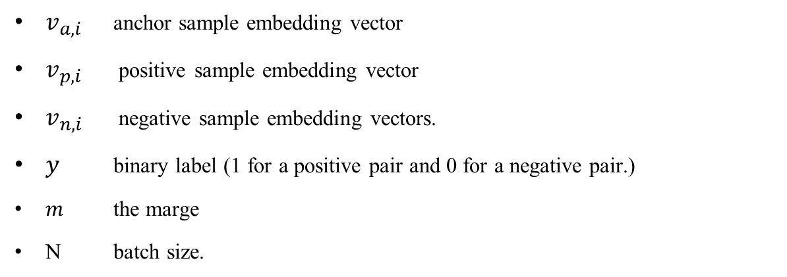
Contrastive Loss Function
$v_{a,i}$ anchor sample embedding vector
$v_{p,i}$ positive sample embedding vector
$v_{n,i}$ negative sample embedding vectors.
$y$ binary label (1 for a positive pair and 0 for a negative pair.)
$m$ the marge
N batch size.
SCHOOL OF - to apply in all slides at the same time edit in Insert > Header & Footer

Slide 17
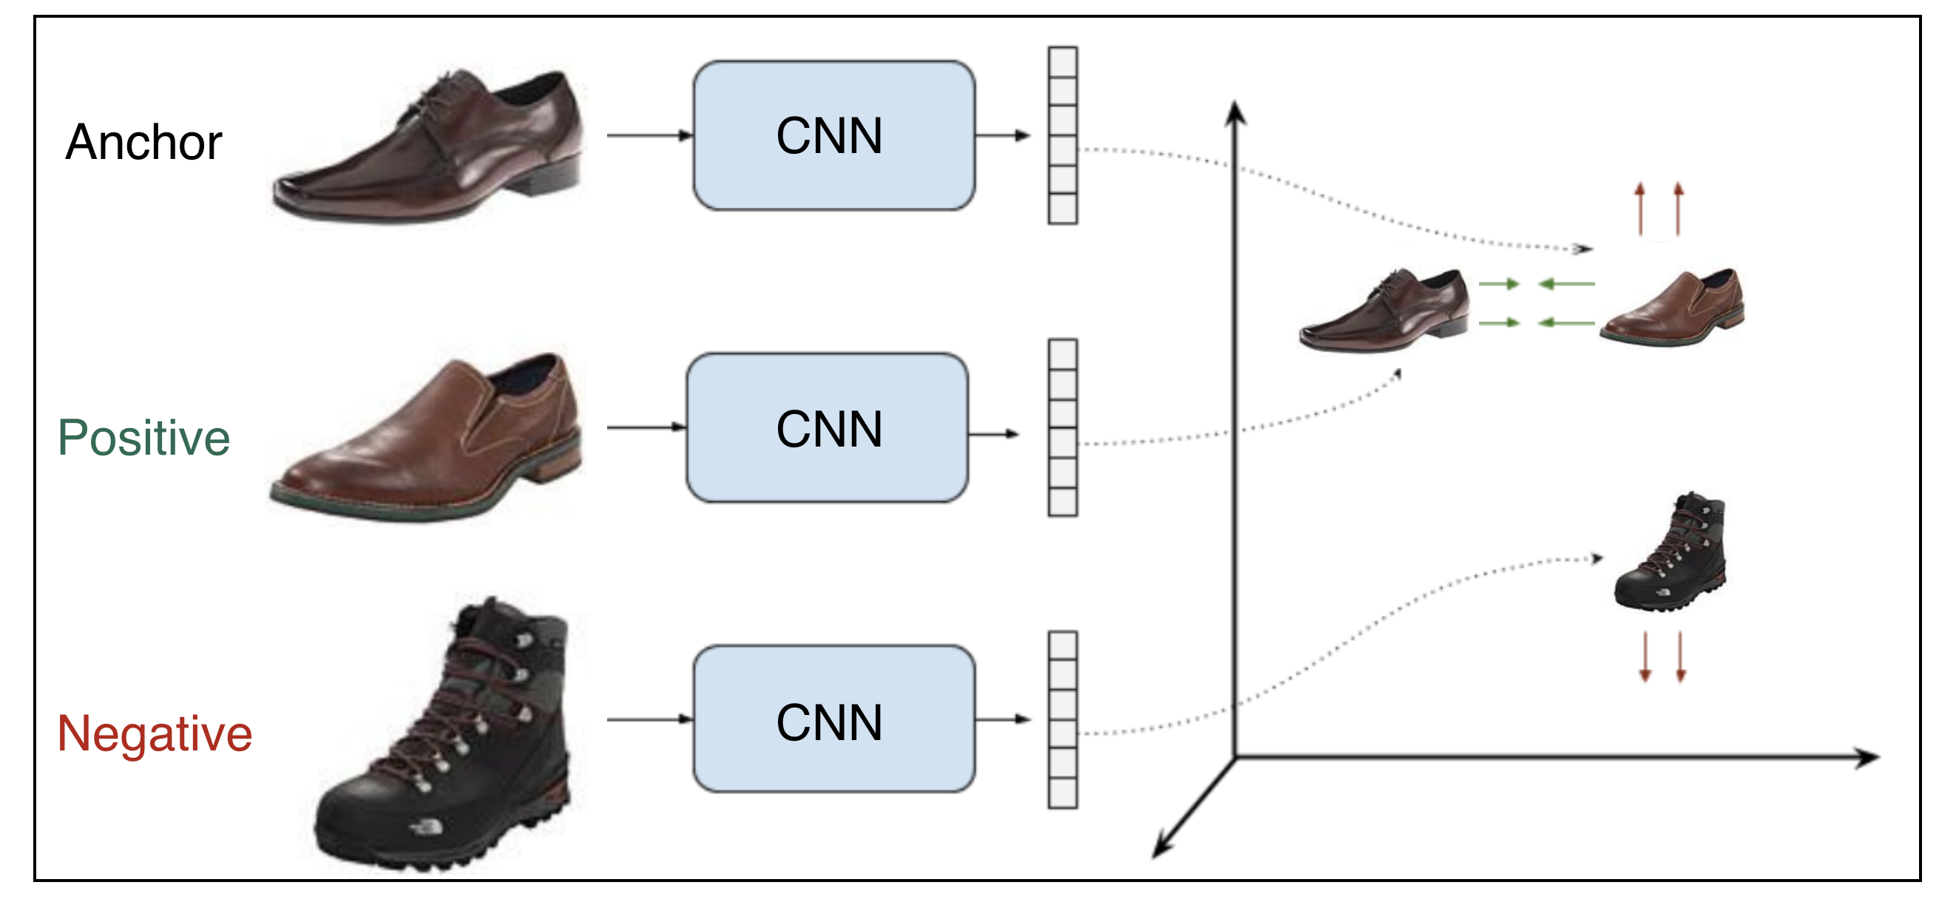
Triplet Loss
Shared weights
pull
push
Shared weights
Figure X: Example of a contrastive ranking loss training setup
SCHOOL OF - to apply in all slides at the same time edit in Insert > Header & Footer

Slide 18
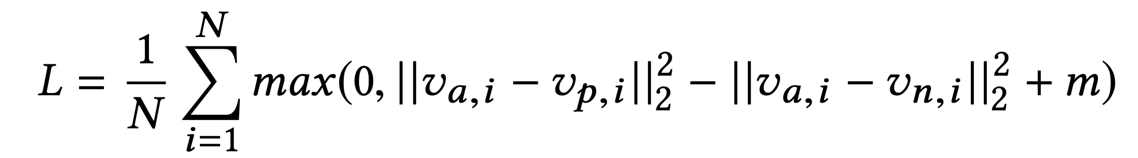
Triplet Loss
Assume x_{a,i},x_{p,i},x_{n,i} are the anchor sample, positive sample and negative sample in a triplet respectively. v_{a,i},v_{p,i},v_{n,i} are their correspondent embedding vectors. m is the marge and N is the batch size.
SCHOOL OF - to apply in all slides at the same time edit in Insert > Header & Footer

Slide 19
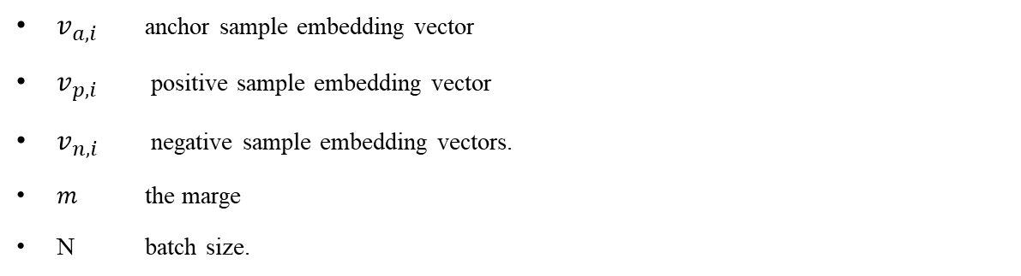
Triplet Loss Function
$v_{a,i}$ anchor sample embedding vector
$v_{p,i}$ positive sample embedding vector
$v_{n,i}$ negative sample embedding vectors.
$m$ the marge
N batch size.
SCHOOL OF - to apply in all slides at the same time edit in Insert > Header & Footer

Slide 20
Triplet Loss
https://www.tensorflow.org/addons/tutorials/losses_triplet

Slide 21
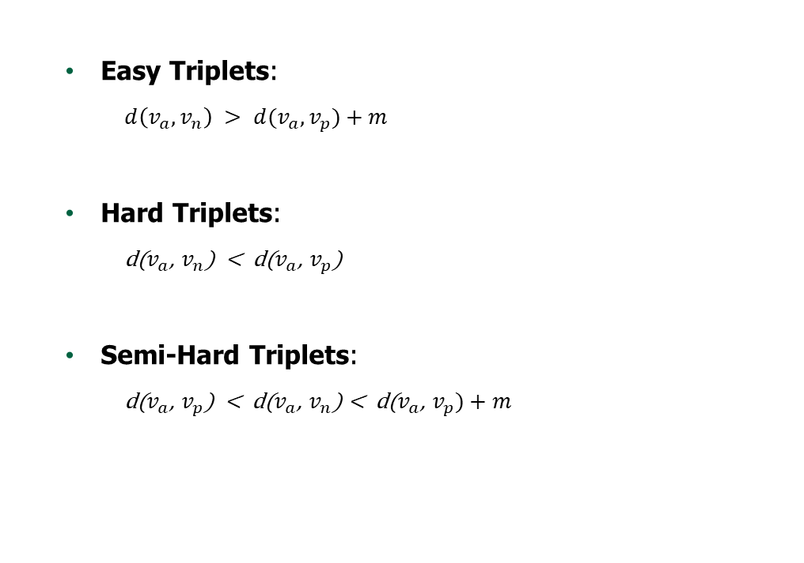
Triplet Mining
Easy Triplets:
$d\left(v_{a},v_{n}\right) > d(v_{a},v_{p})+m$
Hard Triplets:
d($v_{a}$, $v_{n}$) < d($v_{a}$, $v_{p}$)
Semi-Hard Triplets:
d($v_{a}$, $v_{p}$) < d($v_{a}$, $v_{n}$) < d($v_{a}$, $v_{p})+m$
Easy negatives
Semi-hard negatives
Hard negatives
margin
A
P
Figure X: Types of negatives - given an anchor and a positive
SCHOOL OF - to apply in all slides at the same time edit in Insert > Header & Footer

Slide 22
Implementation

Slide 23
Pairs

Slide 24
Implementation
Offline pair mining
defined before training
Online triplet mining
defined for every batch during training

Slide 25
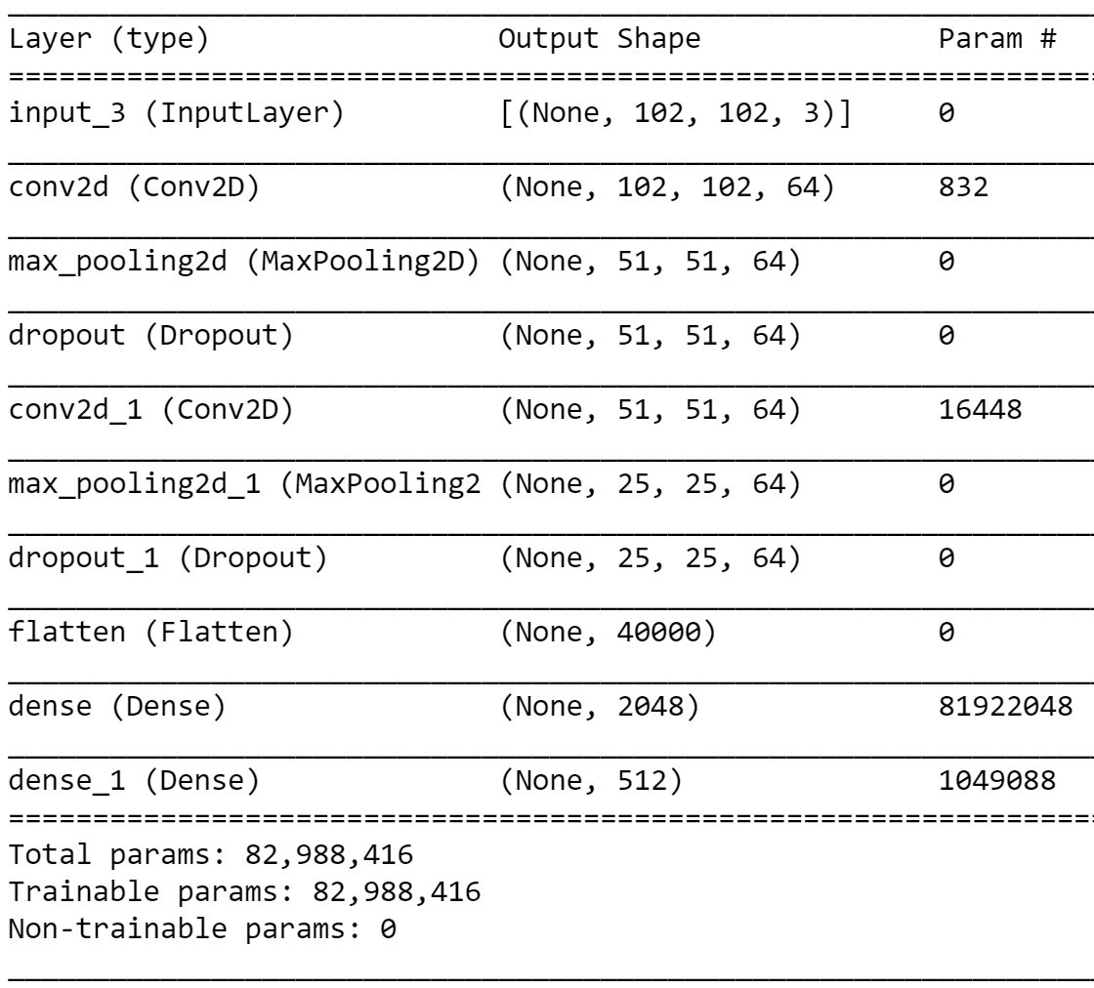
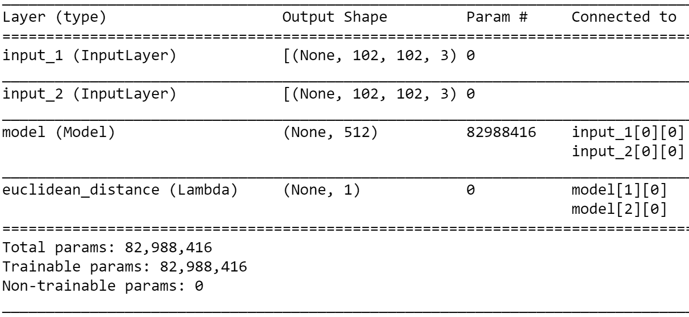
Implementation
Offline pair mining
defined before training
Fig.: CNN architecture (feature extraction)
Fig: Siamese network architecture

Slide 26
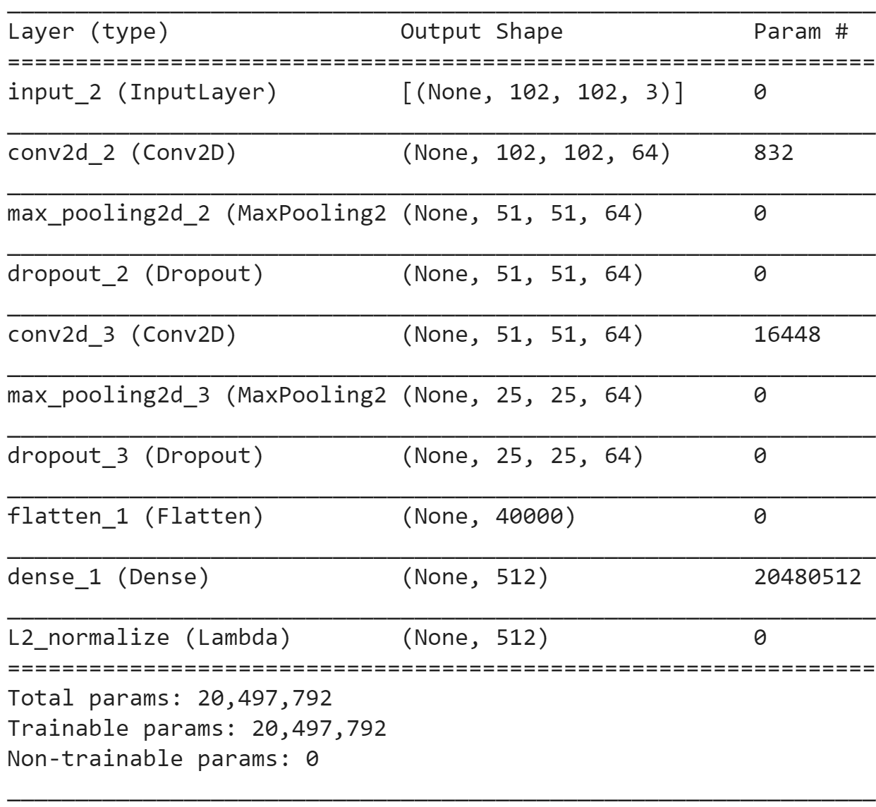
Implementation
Online triplet mining
defined for every batch during training
used semi-hard
Fig: Our Siamese architecture for triplet loss

Slide 27
Evaluation

Slide 28
Evaluation – old run
model | Accuracy % | Epochs | Time (mins)
Xception (T0) | 91.8 | 20 | 1.8
Xception + dense (T1) | 90.7 | 20 | 3.5
Xception All (T2) | 95.1 | 10 | 5.4
Our Siamese + Con. Loss (S0) | 92.75 | 32 | 6
Our Siamese + Triplet. Loss (S1) | 91.02 | 20 | 2
Xception + Siamese (S2) | 95.85 | 10 | 2
model | Accuracy % | Epochs | Time (mins)
Xception (T0) | 89.9 | 20 | 4
Xception + dense (T1) | 89.3 | 20 | 4
Xception All (T2) | 94.0 | 10 | 6
Our Siamese + Con. Loss (S0) | 90.20 | 32 | 14
Our Siamese + Triplet. Loss (S1) | - | - | -
Xception + Siamese (S2) | - | - | -
Table1: Results on 1500 images
Table2: Results on 2500 images

Slide 29
Evaluation – new run
model | Accuracy % | Epochs | Time (mins)
Xception (T0) | 93.61 | 20 | 2.1
Xception + dense (T1) | 94.65 | 20 | 2.5
Xception All (T2) | 97.4 | 10 | 2.2
Our Siamese + Con. Loss (S0) | 92.75 | 32 | 6
Our Siamese + Triplet. Loss (S1) | 91.02 | 20 | 2
Xception + Siamese (S2) | 95.85 | 10 | 2
model | Accuracy % | Epochs | Time (mins)
Xception (T0) | 91.8 | 20 | 4
Xception + dense (T1) | 90.7 | 20 | 4
Xception All (T2) | 94.0 | 10 | 6
Our Siamese + Con. Loss (S0) | 90.20 | 32 | 14
Our Siamese + Triplet. Loss (S1) | - | - | -
Xception + Siamese (S2) | - | - | -
Table1: Results on 1500 images
Table2: Results on 2500 images

Slide 30
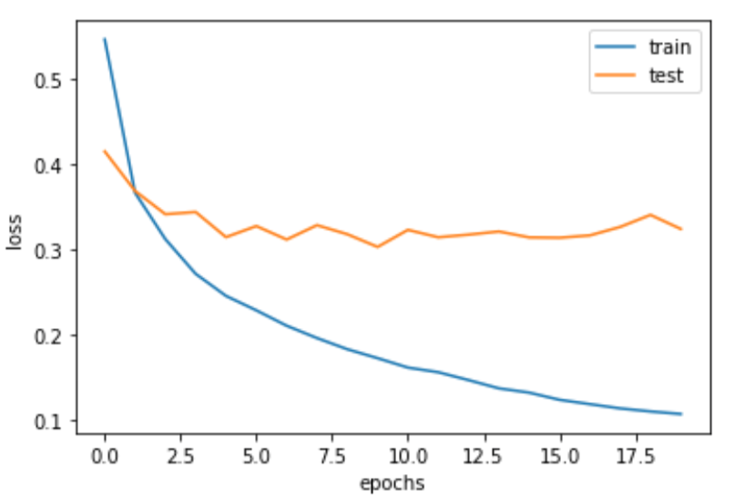
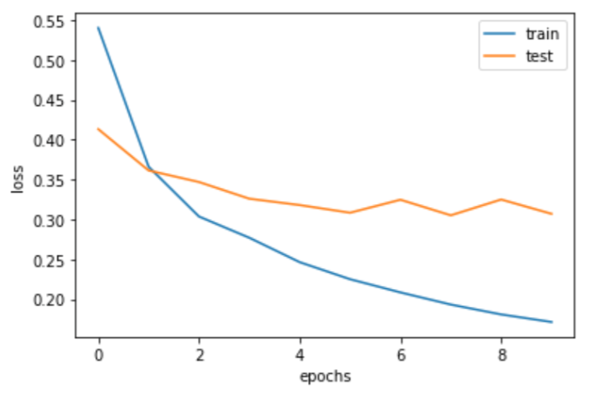
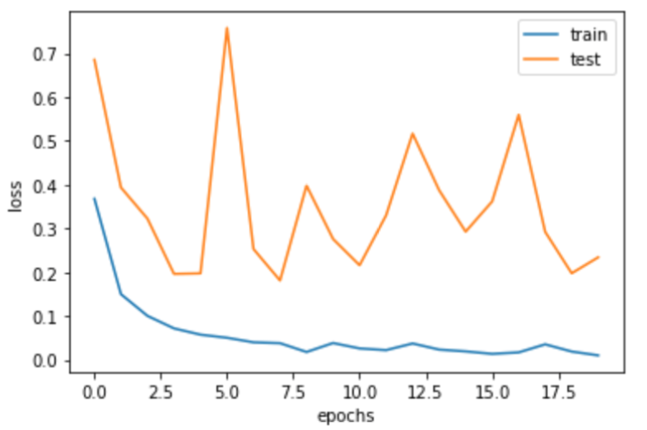
Transfer Learning
(a) Xception
(b) Xception + dense
(c) Xception All
Figure X: loss diagram for transfer learning

Slide 31
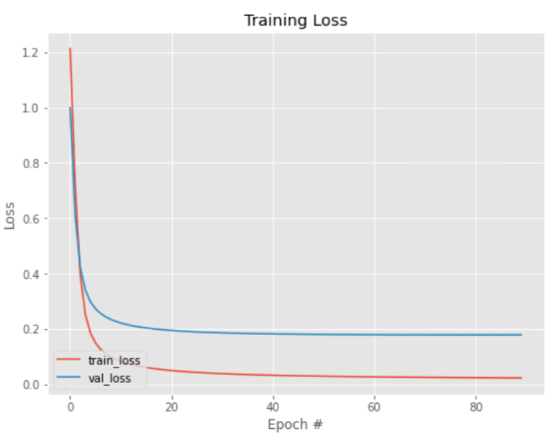
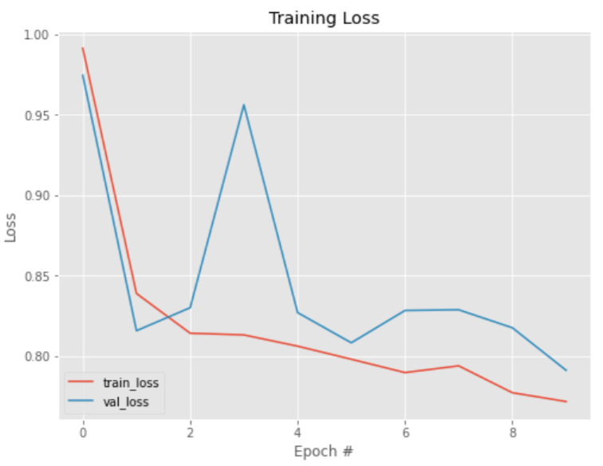
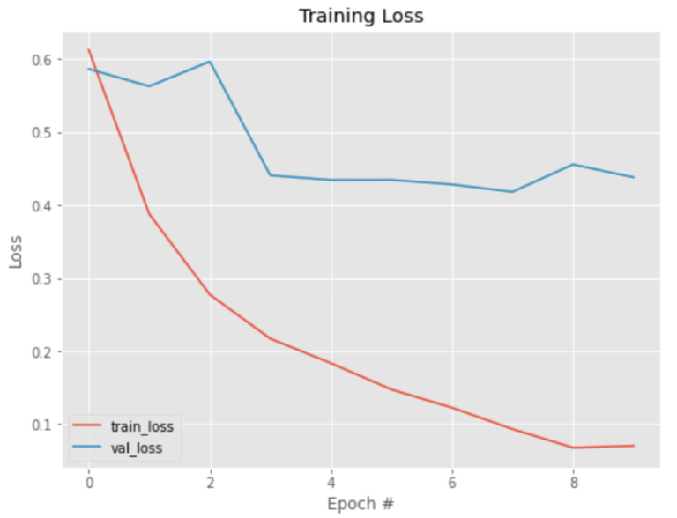
Contrastive Loss
Our Siamese + Con. loss
Our Siamese + Triplet. loss
Xception + Siamese
Figure X: loss diagram for transfer learning

Slide 32
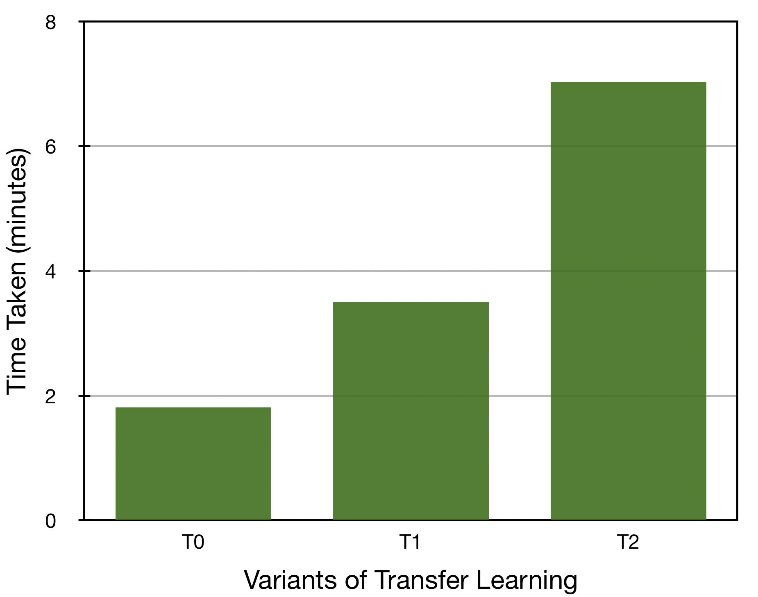
Comparison of Transfer Learning
Figure X: Description

Slide 33
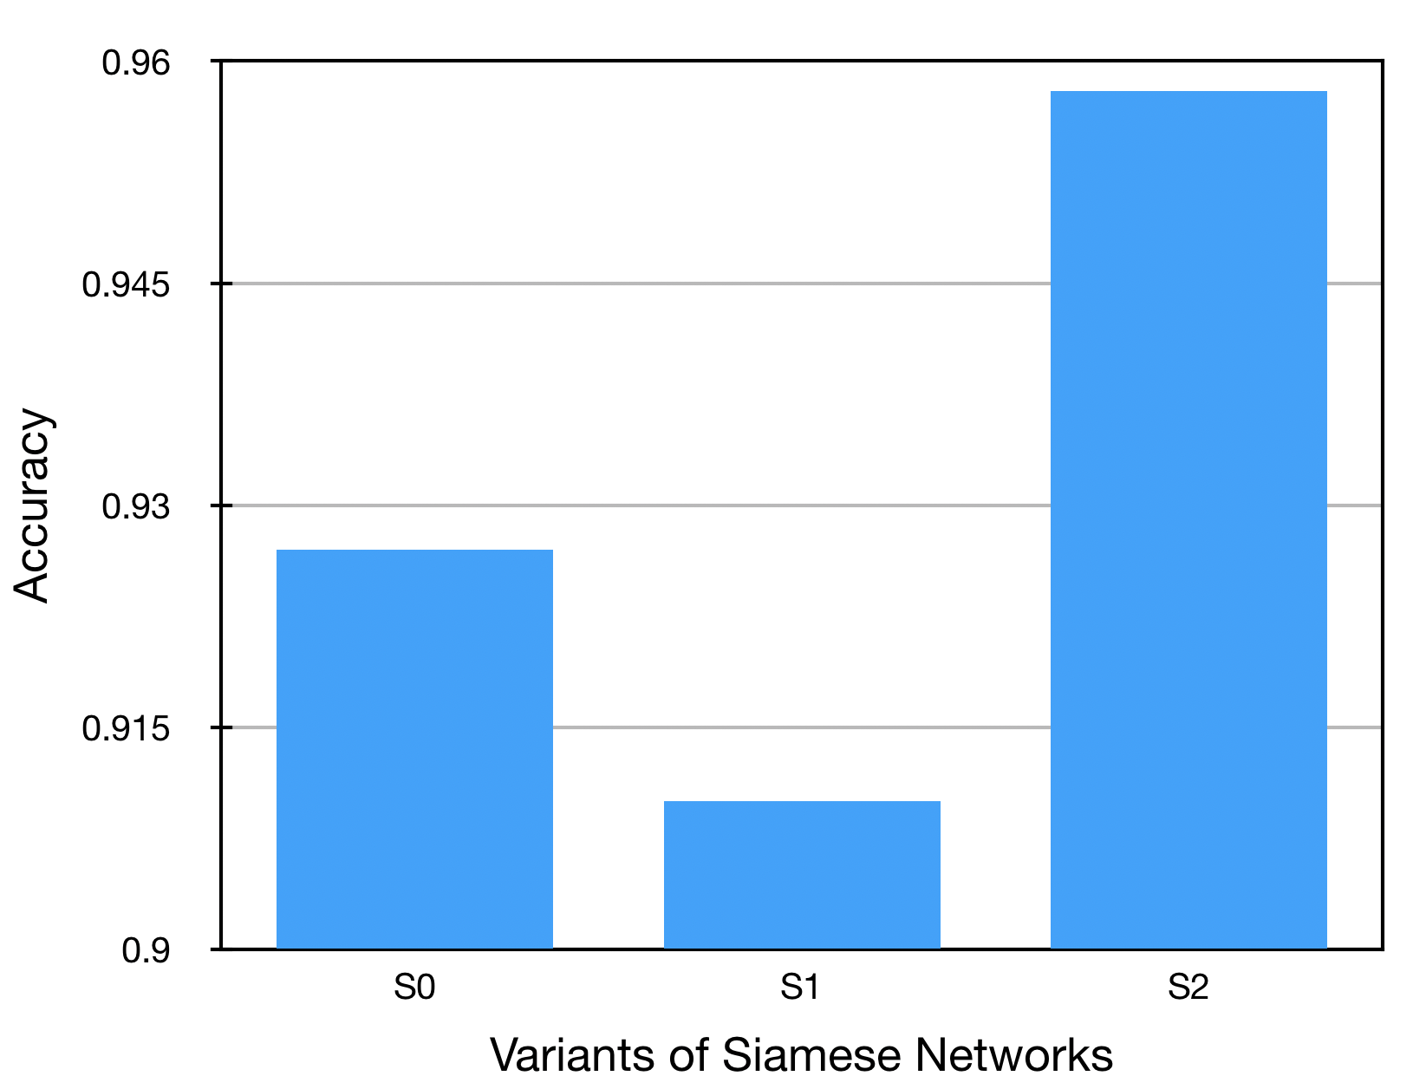
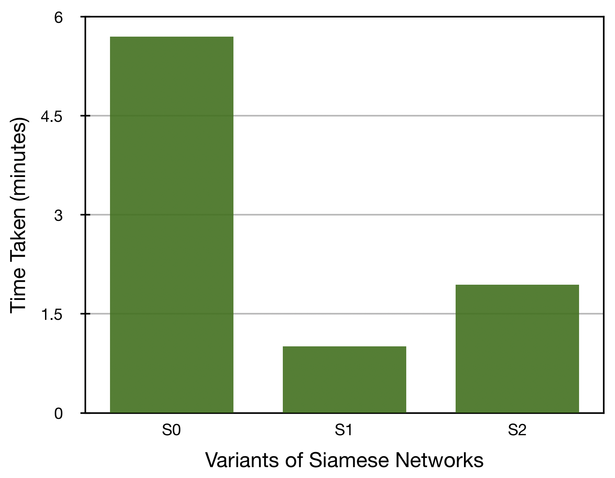
Comparison of Siamese Network
Figure X: Description

Slide 34
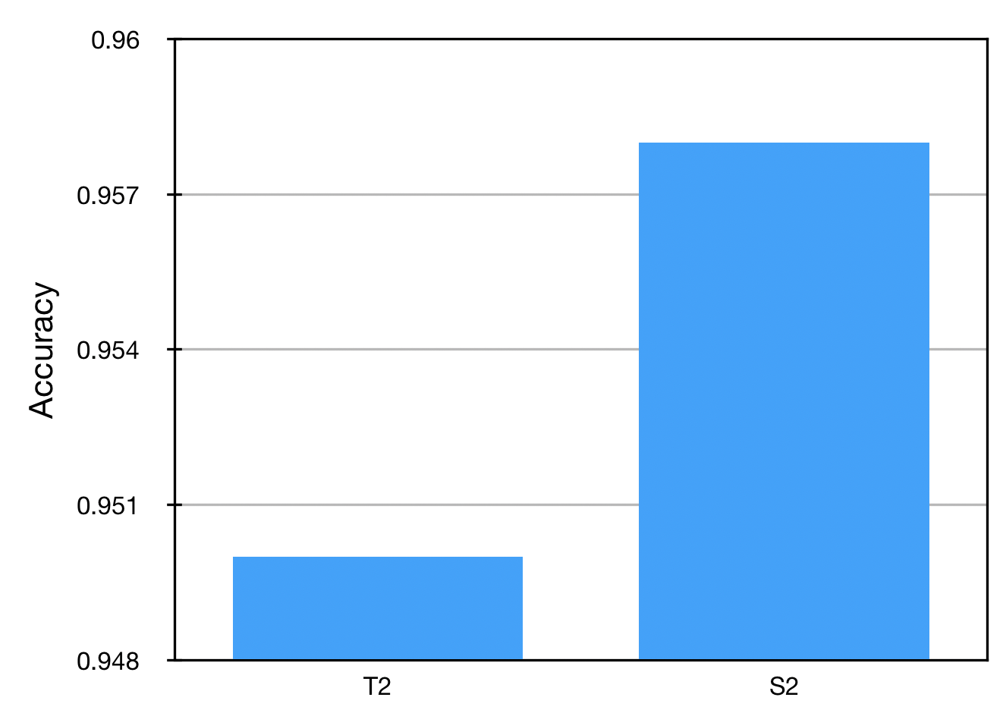
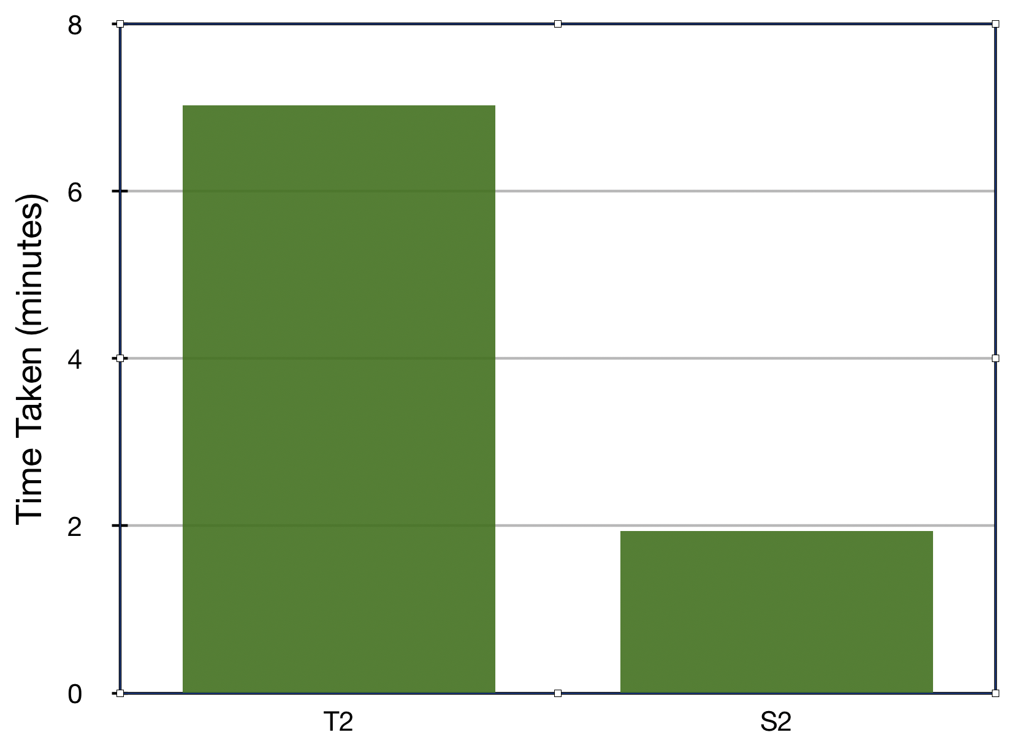
Comparison best models
Figure X: Description

Slide 35
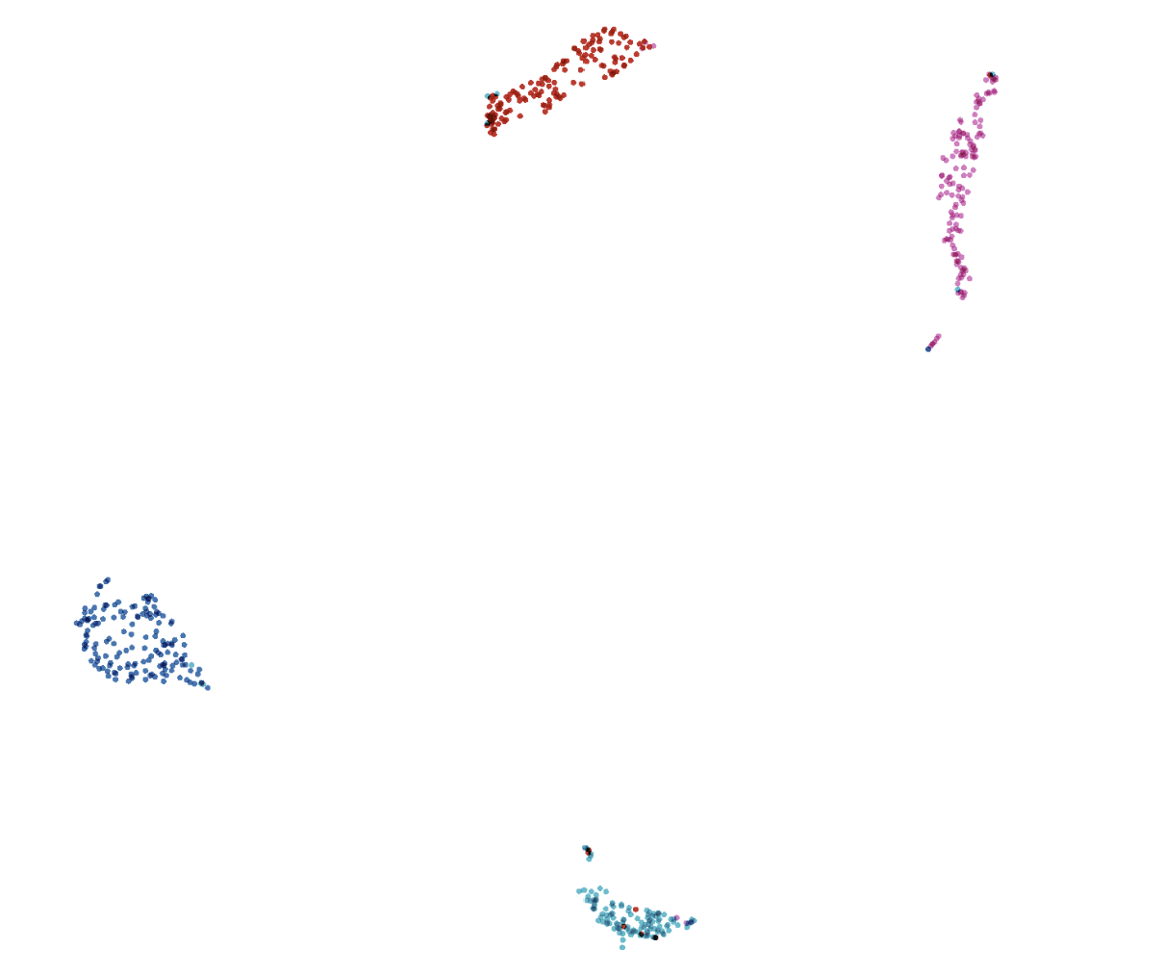
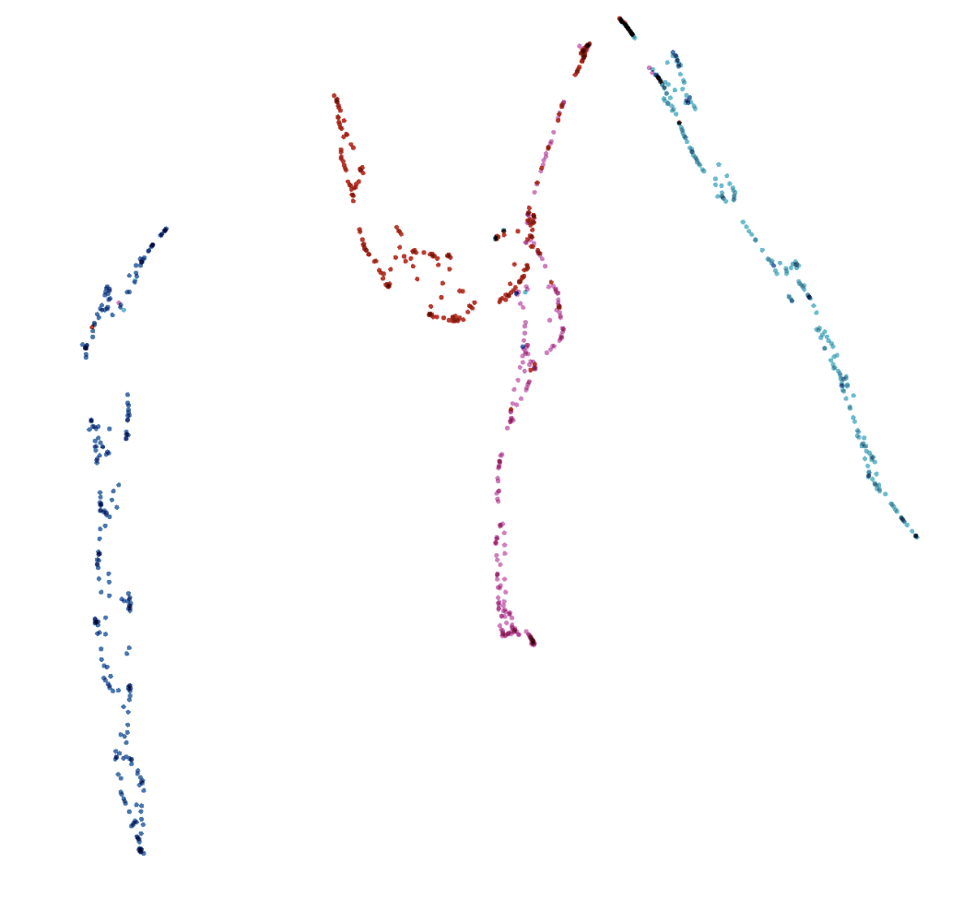
Comparison best models
(a) Xception + Siamese
(b) Xception all
Figure X: visualization of embedded test data projected to 2D space with UMAP using https://projector.tensorflow.org/

Slide 36
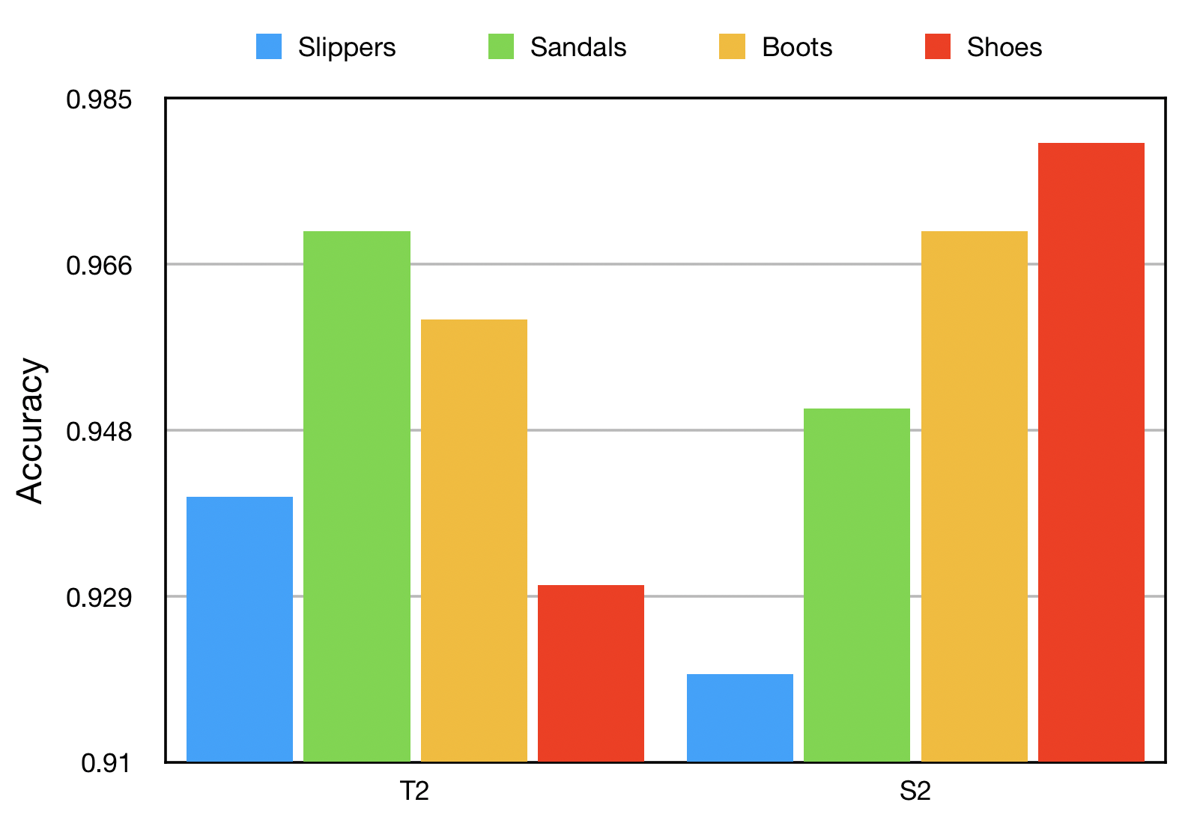
Analyze each class
Figure X: accuracy per class of best models

Slide 37
Thank you!

